Slide 1
Introduction to Computer Networks
Lecture 1

Slide 2
Textbook / References
“Behrouz A Forouzan” - Data Communications and Networking.
“Behrouz A Forouzan” – TCP/IP protocols suite
“D. Comer”- Internetworking with TCP/IP
“Kurose Ross”-Computer Networking A Top-Down Approach

Slide 3
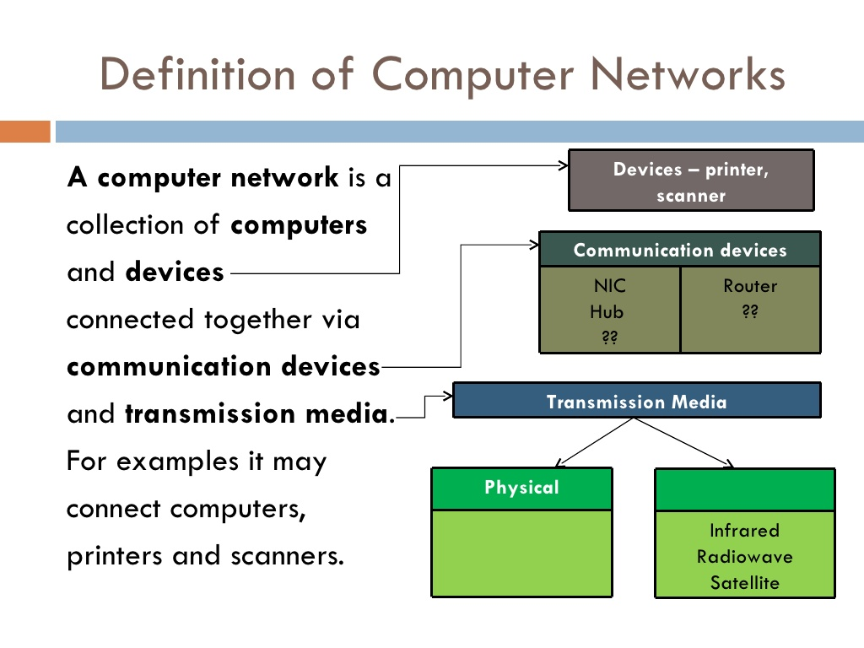

Slide 4
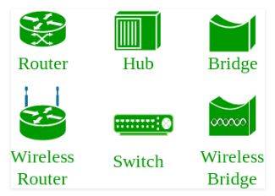
Networking Devices

Slide 5
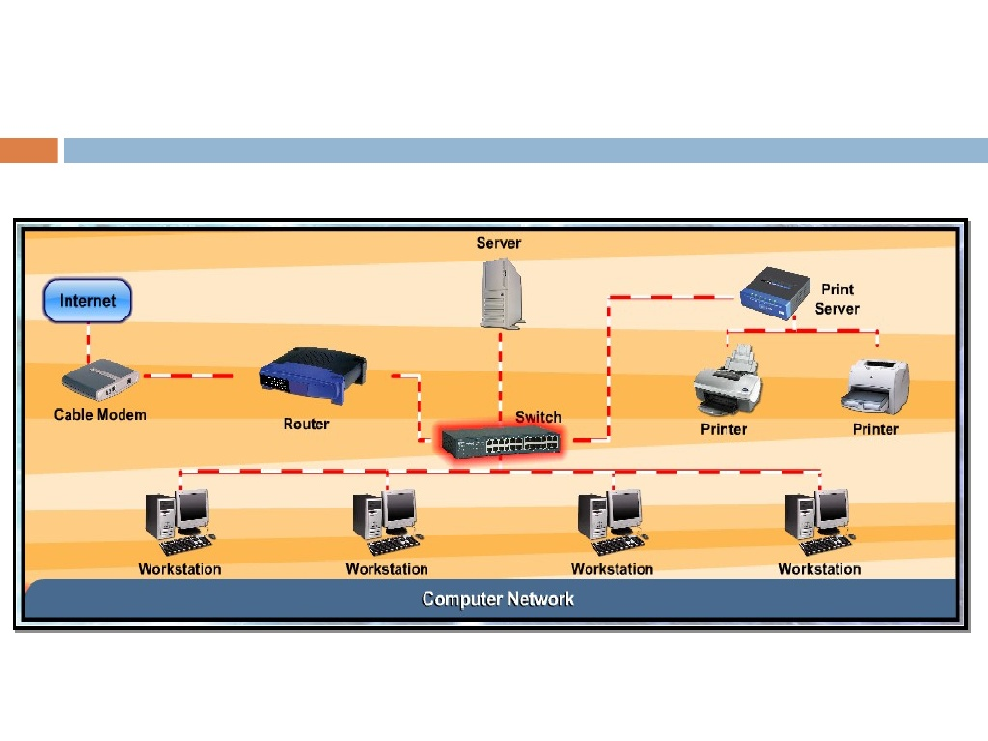

Slide 6
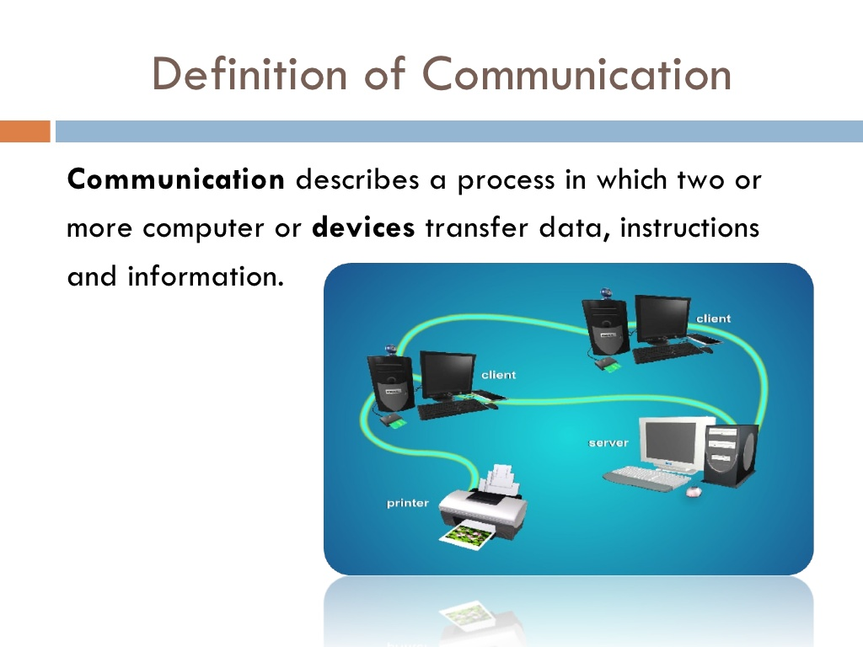

Slide 7
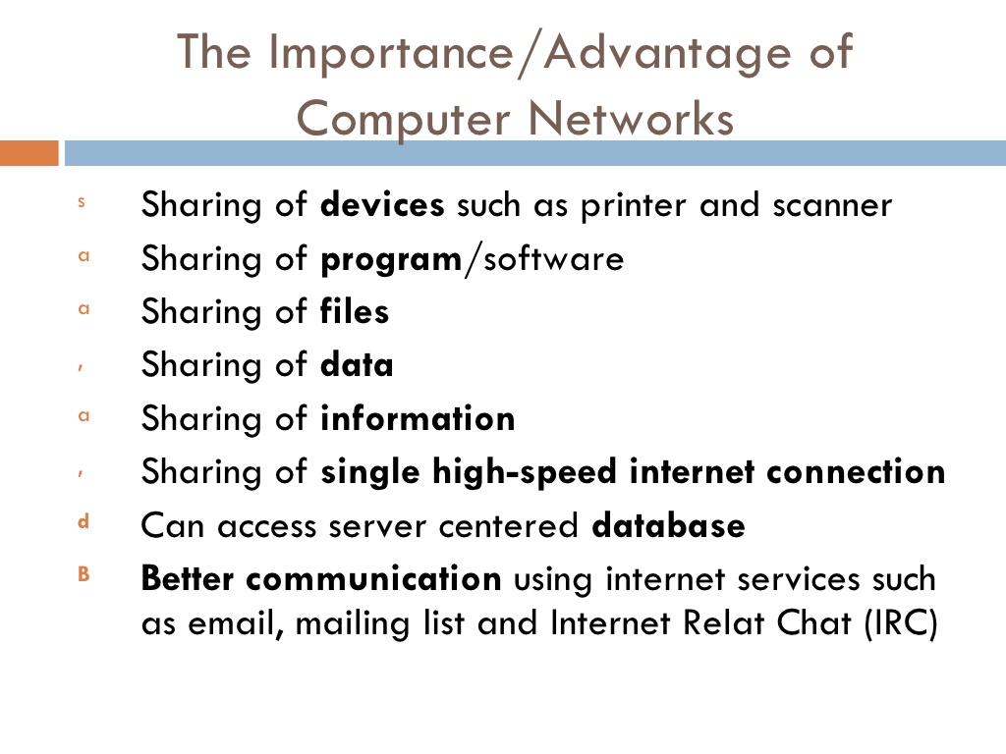

Slide 8
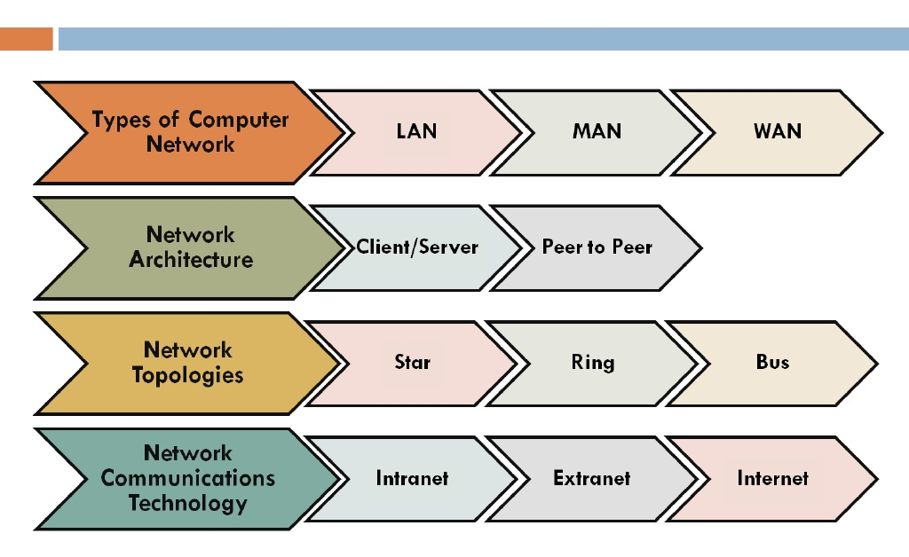

Slide 9
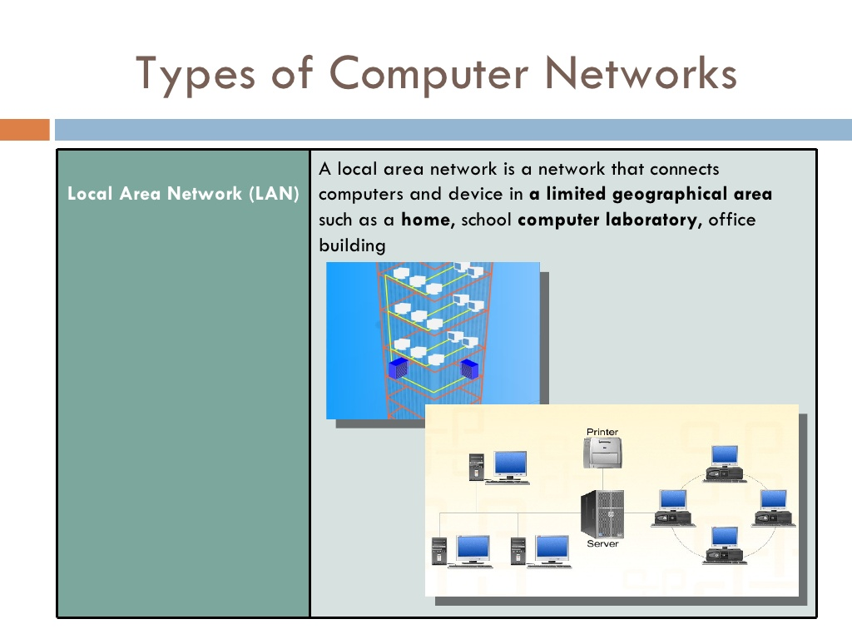

Slide 10
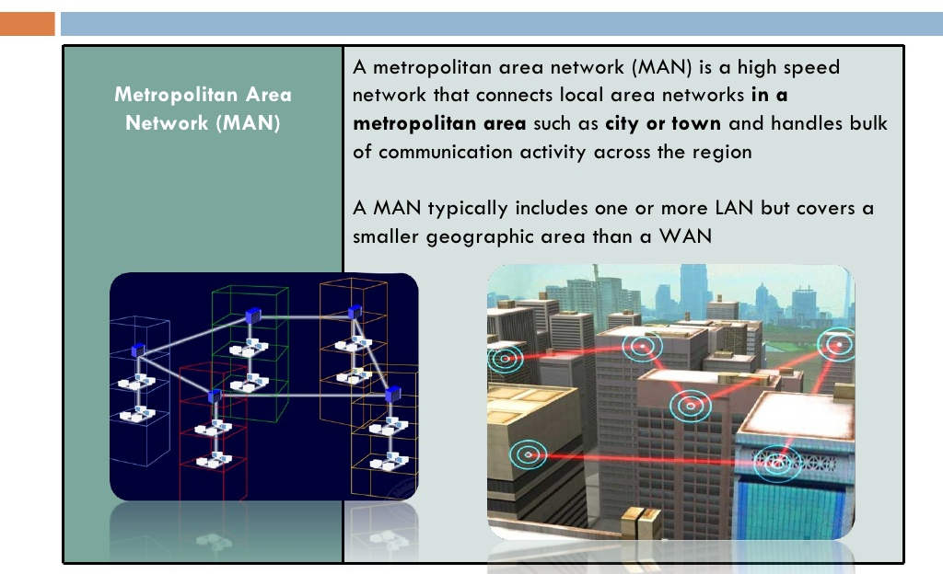

Slide 11
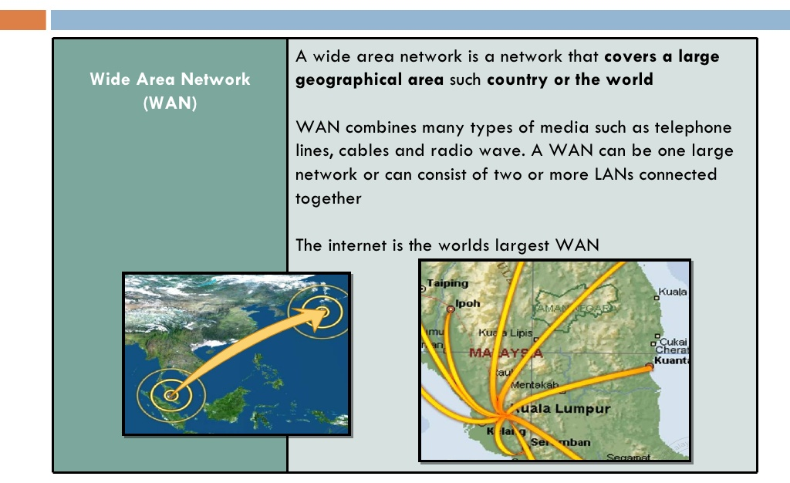

Slide 12
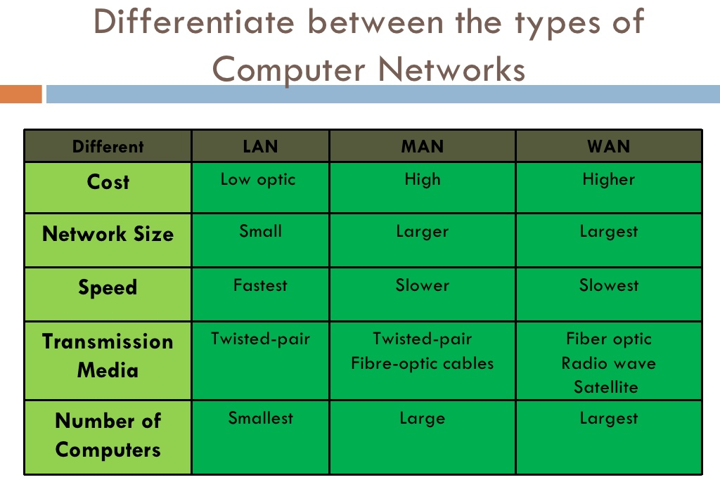

Slide 13
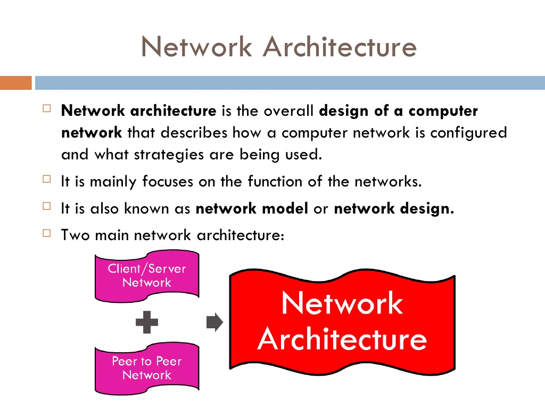

Slide 14
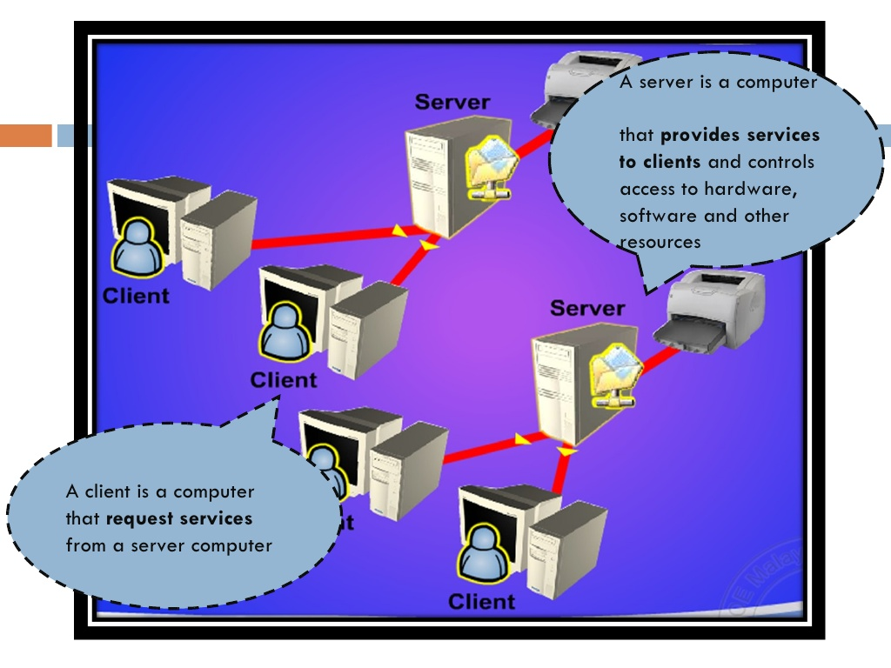

Slide 15
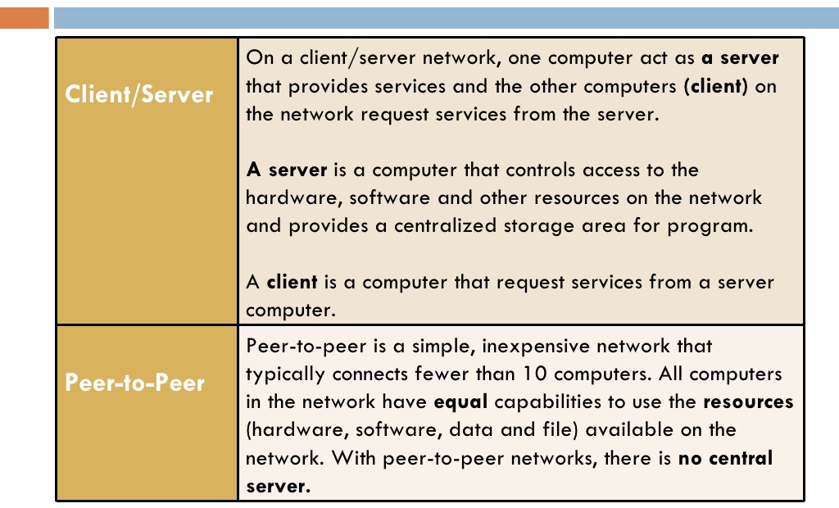

Slide 16
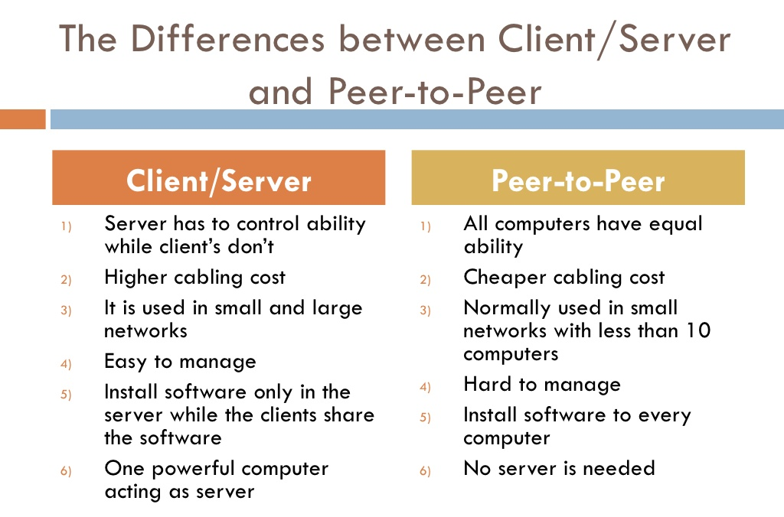

Slide 17
Network topology

Slide 18
Topology
Topology refers to the layout of connected devices on a network.
Here, some logical layout of topology.
Mesh
Star
Bus
Ring

Slide 19
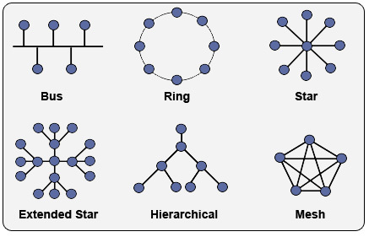
Network Topology

Slide 20
Mesh Topology
Here every device has a point to point link to every other device.
Node 1 node must be connected with n-1 nodes.
A fully connected mesh can have n(n-1)/2 physical channels to link n devices.
It must have n-1 I/O ports.

Slide 21
Mesh Topology
Advantages:
They use dedicated links so each link can only carry its own data load. So traffic problem can be avoided.
It is robust. If any one link get damaged it cannot affect others.
It gives privacy and security.(Message travels along a dedicated link)
Fault identification and fault isolation are easy.

Slide 22
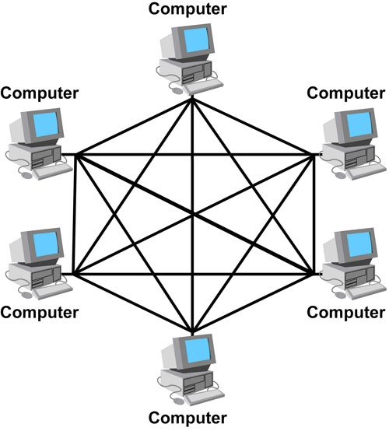
Mesh Topology

Slide 23
Mesh Topology
Disadvantages:
The amount of cabling and the number of I/O ports required are very large. Since every device is connected to each devices through dedicated links.
The sheer bulk of wiring is larger then the available space.
Hardware required to connected each device is highly expensive.

Slide 24
Mesh Topology
Applications:
Telephone Regional office.
WAN.(Wide Area Network).

Slide 25
Star Topology
Here each device has a dedicated point-to-point link to the central controller called “Hub”(Act as a Exchange).
There is no direct traffic between devices.
The transmission are occurred only through the central “hub”.
When device 1 wants to send data to device 2; First sends the data to hub. Which then relays the data to the other connected device.

Slide 26
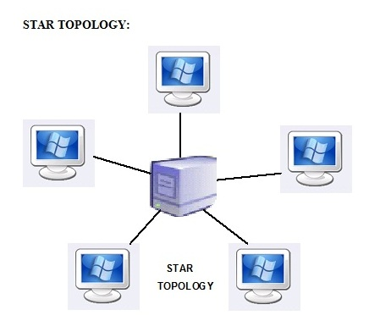
Star Topology

Slide 27
Star Topology
Advantages:
Less expensive then mesh since each device is connected only to the hub.
Installation and configuration are easy.
Less cabling is need then mesh.
Robustness.(if one link fails, only that links is affected. All other links remain active)
Easy to fault identification & to remove parts.
No distruptions to the network then connecting(or) removing devices.

Slide 28
Star Topology
Disadvantages:
Even it requires less cabling then mesh when compared with other topologies it still large.(Ring or bus).
Dependency(whole n/w dependent on one single point(hub). When it goes down. The whole system is dead.

Slide 29
Applications
Star topology used in Local Area Networks(LANs).
High speed LAN often used STAR.

Slide 30
Bus Topology
A bus topology is multipoint.
Here one long cable act as a backbone to link all the devices are connected to the backbone by drop lines and taps.
Drop line- is the connection b/w the devices and the cable.
Tap- is the splitter that cut the main link.
This allows only one device to transmit at a time.

Slide 31
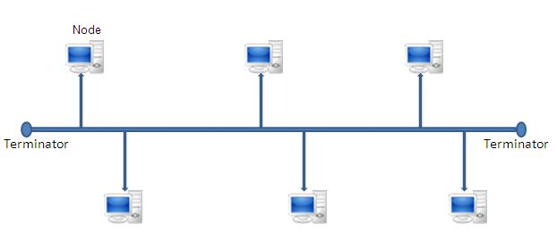
Bus Topology

Slide 32
Bus Topology
A device want to communicate with other device on the n/ws sends a broadcast message onto the wire all other devices see.
But only the intended devices accepts and process the message.

Slide 33
Bus Topology
Advantages:
Ease of installation
Less cabling
Disadvantages:
Difficult reconfiguration and fault isolation.
Difficult to add new devices.
Signal reflection at top can degradation in quality.
If any fault in backbone can stops all transmission.

Slide 34
Bus Topology
Applications:
Most computer motherboard.

Slide 35
Ring Topology
Here each device has a dedicated connection with two devices on either side.
The signal is passed in one direction from device to device until it reaches the destination and each device have repeater.
When one device received signals instead of intended another device, its repeater then regenerates the data and passes them along.
To add or delete a device requires changing only two connections.

Slide 36
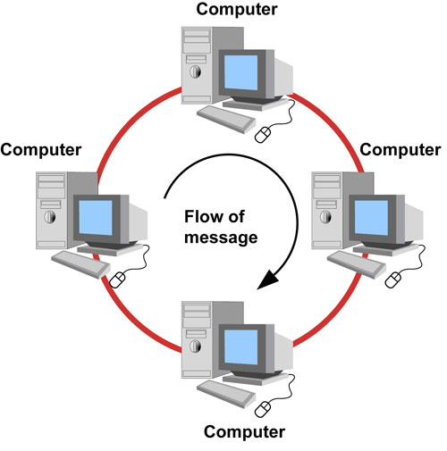
Ring Topology

Slide 37
Ring Topology
Advantages:
Easy to install.
Easy to reconfigure.
Fault identification is easy.
Disadvantages:
Unidirectional traffic.
Break in a single ring can break entire network.

Slide 38
Ring Topology
Applications:
Ring topologies are found in some office buildings or school campuses.
Today high speed LANs made this topology less popular.

Slide 39
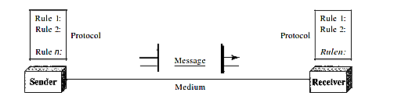
Basic Data Communication
Data communications are the exchange of data between two devices via some form of transmission medium such as a wire cable. For data communications to occur, the communicating devices must be part of a communication system made up of a com­bination of hardware (physical equipment) and software (programs).

Slide 40
Basic Data Communication cont.
A data communications system has five components:
1. Message: The message is the information (data) to be communicated. Popular forms of information include text, numbers, pictures, audio, and video.
2. Sender: The sender is the device that sends the data message. It can be a com­puter, workstation, telephone handset, video camera, and so on.
3. Receiver: The receiver is the device that receives the message. It can be a com­puter, workstation, telephone handset, television, and so on.
4. Transmission medium: The transmission medium is the physical path by which a message travels from sender to receiver. Some examples of transmission media include twisted-pair wire, coaxial cable, fiber-optic cable, and radio waves.
5. Protocol: A protocol is a set of rules that govern data communications. It repre­sents an agreement between the communicating devices. Without a protocol, two devices may be connected but not communicating, just as a person speaking French cannot be understood by a person who speaks only Japanese.

